Slide 1
AI-BASED FAQ CHATBOT WITH VOICE ASSISTANCE
Presented By:
B. Baskar Raju(217r1a0513)
B. Narsimha(217r1a0507)
S. Vinayak(217r1a0554)
Under the Guidance of:
Mr. G. Vinesh Shankar
(Assistant Professor)
Department of CSE Batch No: 4

Slide 2
CSE Department Vision and Mission
Vision:
To Provide quality education and a conducive learning environment in computer engineering that foster critical thinking, creativity, and practical problem-solving skills.
Mission:
1. To educate the students in fundamental principles of computing and induce the skills needed to solve practical problems.
2. To provide State-of-the-art computing laboratory facilities to promote industryinstitute interaction to enhance student’s practical knowledge.
3. To Inculcate self-learning abilities, team spirit, and professional ethics among the students to serve society.

Slide 3
Table of Contents:
Introduction and overview of the project (Abstract).
Existing system.
Disadvantage
Proposed system.
Advantages
Hardware and software requirements.
Novelty of your Projecth. Architecturei. Modules
UML Diagrams
Sample Code
Results
Conclusion
Future Scope
References
Github Link

Slide 4
ABSTRACT:
Objective:
Develop an AI-based FAQ chatbot with voice assistance.
Leverage advanced AI, NLP, and voice recognition technologies.
Purpose:
Provide a convenient tool for customer support, information retrieval, and task automation.
Enhance user interaction through personalized and efficient responses.
Functionality:
Assist users in retrieving information from a predefined knowledge base using natural language queries.
Support voice commands for a versatile user experience.
Technology:
Utilize state-of-the-art NLP techniques for understanding user queries.
Employ machine learning algorithms to extract relevant information and generate real-time responses.
User Experience:
Offer an intuitive and interactive interface for seamless communication.
Enable users to interact with the chatbot through voice or text, enhancing accessibility.

Slide 5
Existing System:
Traditional FAQ pages on websites or manual customer service processes.
Users navigate static information or contact support agents via email or phone calls.
Static information with no dynamic interaction.
Longer response times due to manual processes.
Challenges for users with disabilities in accessing information or communicating.
Varied responses depending on the support agent or static content.
Text-based interactions through web browsers.
No support for spoken communication, limiting users who prefer voice-based interaction.
Human agents handle inquiries, leading to:
Delays in response times.
Potential inconsistencies in the information provided.

Slide 6
Disadvantages of the Existing System:
Lack of Interactivity:
Static FAQ pages with no dynamic or real-time interaction.
Users cannot engage in conversational queries.
Limited Accessibility:
Text-based systems may not cater to users with disabilities (e.g., visual or hearing impairments).
No support for voice-based interactions.
Inconsistent User Experience:
Responses vary depending on the support agent or static content.
Lack of uniformity in information provided.
Dependence on Human Agents:
Manual handling of inquiries leads to inefficiencies.
Human errors or inconsistencies in information provided.
Limited Communication Channels:
Primarily text-based interactions through web browsers.
No support for voice commands or multi-modal communication.

Slide 7
PROPOSED SYSTEM:
AI-Based FAQ Chatbot with Voice Assistance:
Leverages advanced AI, NLP, and voice recognition technologies.
Provides a more interactive, personalized, and accessible user experience compared to traditional systems.
Personalization and Context Awareness:
Uses machine learning algorithms to tailor responses based on user preferences.
Maintains context across interactions for coherent and relevant conversations.
Delivers a more engaging and personalized user experience.
Improved Accessibility:
Supports voice-based interactions for users with disabilities or those who prefer speaking over typing.
Ensures inclusivity and ease of use for a wider range of users.
Real-Time Responses:
Provides instant answers to user queries, reducing wait times.
Eliminates the need for manual intervention in most cases.
Scalability and Efficiency:
Handles a large volume of queries simultaneously without compromising performance.
Reduces the workload on human support agents.
Cost-Effective Solution:
Reduces operational costs by automating customer support.
Eliminates the need for a large team of human agents.

Slide 8
Advantages of Proposed System:
Enhanced User Interaction:
Supports natural language queries for intuitive communication.
Enables voice commands for users who prefer spoken interaction.
Personalized Responses:
Uses machine learning algorithms to tailor responses based on user preferences.
Maintains context across interactions for coherent and relevant conversations..
Improved Accessibility:
Supports voice-based interactions for users with disabilities or those who prefer speaking over typing.
Ensures inclusivity and ease of use for a wider range of users.
24/7 Availability:
Offers round-the-clock support to users without downtime.
Ensures users can access information anytime, anywhere.
Cost-Effective Solution:
Reduces operational costs by automating customer support.
Eliminates the need for a large team of human agents.

Slide 9
Hardware and Software Requirements:
Hardware Requirements:
Processor: Pentium IV, Minimum 2.80 GHz or more.
Hard Drive: Minimum 40 GB or above
Memory (RAM): Recommended 256 MB or above.
Software Requirements:
Operating System: Windows 8 or above.
Coding Language: Python 3.0.7

Slide 10
Novelty:
Voice-Enabled Interaction:
Integrates voice recognition technology to allow users to interact via voice commands.
Provides an alternative to text-based communication, catering to users who prefer speaking.
Advanced NLP and AI Integration:
Leverages state-of-the-art NLP techniques to understand and process natural language queries.
Uses machine learning algorithms to improve accuracy and context awareness over time.
Real-Time Information Retrieval:
Provides instant, accurate answers by extracting information from a predefined knowledge base.
Reduces the need for manual searching or waiting for human assistance.
Improved Accessibility for Diverse Users:
Enhances accessibility for users with disabilities (e.g., visual or hearing impairments).
Supports voice-based interaction, making it easier for users who struggle with typing.

Slide 11
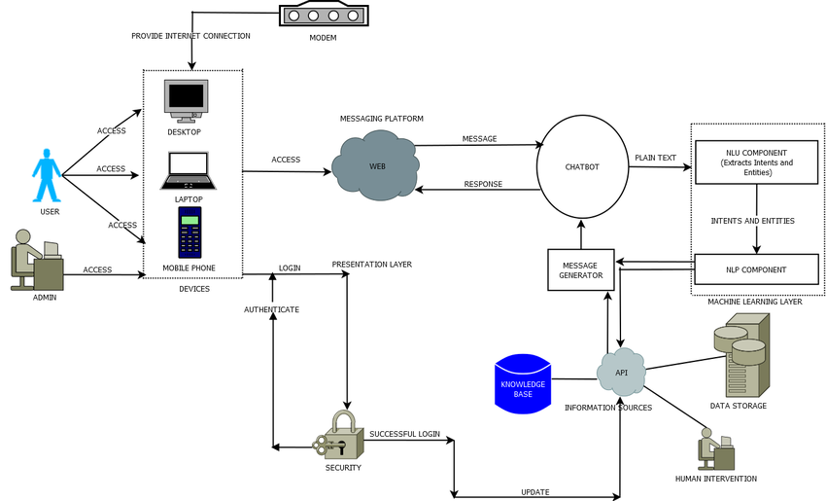
Architecture:

Slide 12
Modules:
Upload Historical Trajectory Dataset : Upload Historical Trajectory Dataset’ button and upload dataset.
Generate Train & Test Model :Generate Train & Test Model’ button to read dataset and to split dataset into train and test part to generate machine learning train model
Run MLP(Multi Layer Perceptron) Algorithm:Run MLP Algorithm’ button to train MLP model and to calculate its accuracy.
Run DDS(Digital Differential Analyzer) with Genetic Algorithm : Run DDS with Genetic Algorithm button to train DDS and to calculate its prediction accuracy.
Predict DDS Type :Predict DDS Type’ button to predict test data
Model Development:
Build machine learning and deep learning models using the preprocessed data.
Focus on developing models for tasks like natural language understanding (NLU) and voice recognition.

Slide 13
Natural Language Understanding (NLU):
Implement advanced NLU techniques to comprehend user queries.
Extract relevant information from the knowledge base.
Voice Recognition Technology:
Integrate voice recognition to enable users to interact with the chatbot using spoken language.
Enhance accessibility and user experience through voice-based interactions.
Knowledge Base Integration:
Connect the chatbot to a predefined knowledge base for accurate information retrieval.
Ensure real-time responses to user inquiries.
Personalization and Context Awareness:
Use machine learning algorithms to personalize responses based on user preferences.
Maintain context across interactions for coherent and relevant conversations.
Testing and Evaluation:
Conduct experiments to evaluate the effectiveness of the chatbot.
Measure accuracy, response time, and user satisfaction.
Deployment:
Deploy the AI-based FAQ chatbot with voice assistance on desired platforms (e.g., websites, mobile apps).
Ensure seamless integration with existing systems.

Slide 14
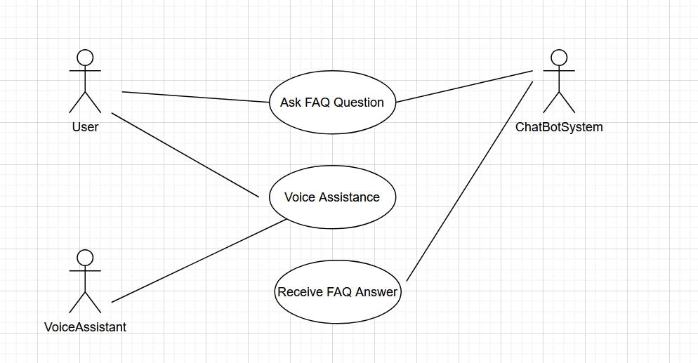
UML Diagrams:
Use Case Diagram:

Slide 15
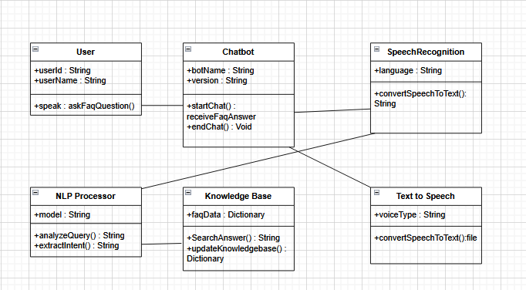
Class Diagram:

Slide 16
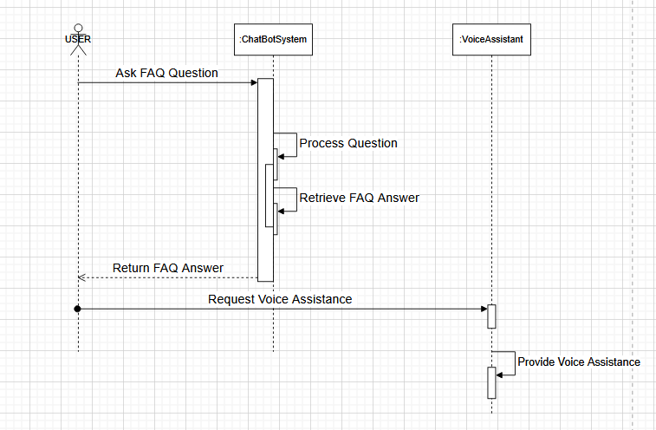
Sequence Diagram:

Slide 17
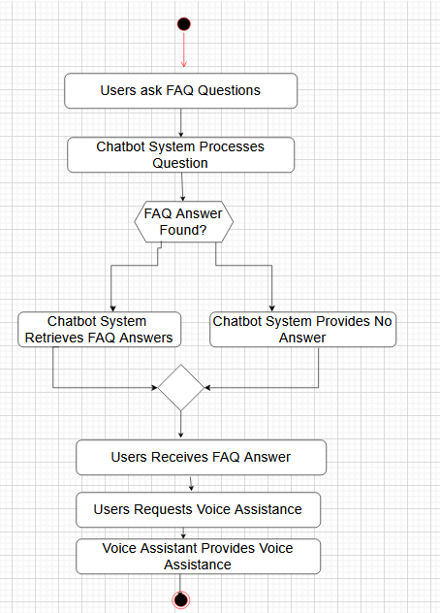
Collaboration Diagram:

Slide 18
Sample Code:
from django.shortcuts import render
from django.template import RequestContext
from django.contrib import messages
from django.http import HttpResponse
import os
import pandas as pd
import numpy as np
import pickle
from sklearn.feature_extraction.text import TfidfVectorizer
import pymysql
from django.views.decorators.csrf import csrf_exempt
import os
import speech_recognition as sr

Slide 19
import subprocess
from numpy import dot
from numpy.linalg import norm
from django.core.files.storage import FileSystemStorage
global uname, questions, answers, vectorizer, tfidf
recognizer = sr.Recognizer()
def trainModel():
global questions, answers, vectorizer, tfidf
questions = []
answers = []
con = pymysql.connect(host='127.0.0.1',port = 3306,user = 'root', password = 'root', database = 'AIChatbot',charset='utf8’)

Slide 20
with con:
cur = con.cursor()
cur.execute("select * FROM faq")
rows = cur.fetchall()
for row in rows:
questions.append(row[0].strip().lower())
answers.append(row[1])
vectorizer = TfidfVectorizer(use_idf=True, smooth_idf=False, norm=None, decode_error='replace')
tfidf = vectorizer.fit_transform(questions).toarray()
print(tfidf)
print(tfidf.shape)
trainModel()
def Chatbot(request):
if request.method == 'GET':
return render(request, 'Chatbot.html', {})

Slide 21
@csrf_exempt
@csrf_exempt
@csrf_exempt
def record(request):
if request.method == "POST":
global answers, vectorizer, tfidf, questions, recognizer
print("Enter")
audio_data = request.FILES.get('data')
fs = FileSystemStorage()
# Delete previous record files if they exist
if os.path.exists('ChatbotApp/static/record.wav'):
os.remove('ChatbotApp/static/record.wav')
if os.path.exists('ChatbotApp/static/record1.wav'):
os.remove('ChatbotApp/static/record1.wav')
# Save the uploaded audio file
fs.save('ChatbotApp/static/record.wav', audio_data)
# Correct path to ffmpeg.exe and the audio files
ffmpeg_path = r"C:\ffmpeg\bin\ffmpeg.exe" # Make sure to include ffmpeg.exe
input_audio_path = r"C:\Users\91817\OneDrive\Documents\Desktop\AIChatbot\ChatbotApp\static\record.wav"

Slide 22
def ViewUser(request):
if request.method == 'GET':
output = ''
output+='<table border=1 align=center width=100%><tr><th><font size="" color="black">Username</th><th><font size="" color="black">Password</th><th><font size="" color="black">Contact No</th>'
output+='<th><font size="" color="black">Email ID</th><th><font size="" color="black">Address</th></tr>'
con = pymysql.connect(host='127.0.0.1',port = 3306,user = 'root', password = 'root', database = 'AIChatbot',charset='utf8')
with con:
cur = con.cursor()
cur.execute("select * from register")
rows = cur.fetchall()
output+='<tr>'
for row in rows:
output+='<td><font size="" color="black">'+row[0]+'</td><td><font size="" color="black">'+str(row[1])+'</td><td><font size="" color="black">'+row[2]+'</td><td><font size="" color="black">'+row[3]+'</td><td><font size="" color="black">'+row[4]+'</td></tr>'
output+= "</table></br></br></br></br>"
context= {'data':output}
return render(request, 'AdminScreen.html', context)

Slide 23
Results:
Admin: admin can login to system using username and password as ‘admin’ and then can
add FAQ new questions and answers and once new question added then AI model
automatically get trained to accommodate new question data. Admin can view all
registered users.
User: user can sign up and login to system and then can start Voice based Chatbot and
then record and send his question and then AI will analyse question to predict best
answer and reply to user with recommended questions.
Extension Concept: in this project as extension we are making Chatbot to save all recorded
voices which user can play and download and this feature is not exists in any existing
voice based Chatbot.
To run project copy content from DB.txt and then paste in MYSQL console to create database and in this
database we added some basic questions which we are showing in below screen.

Slide 24
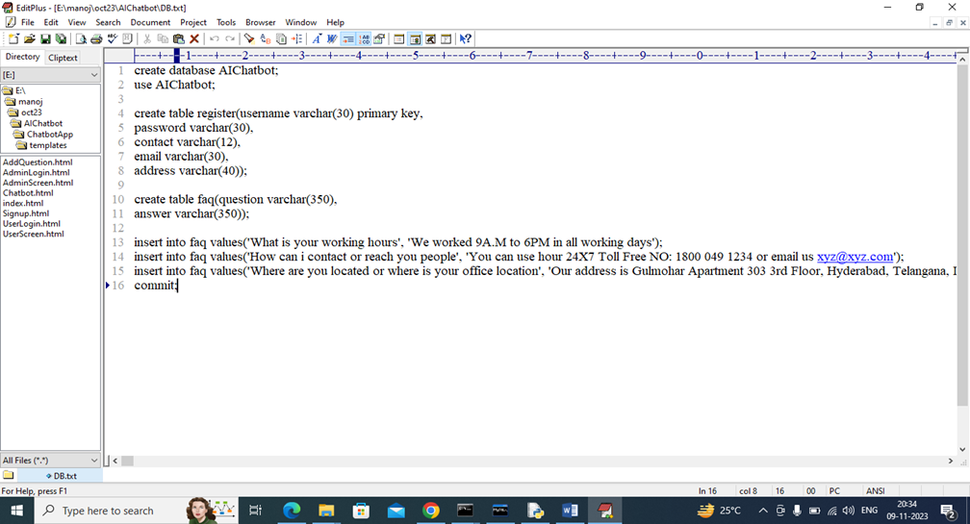
In above database queries in last lines we added some default FAQ questions and you can add new questions by using admin module

Slide 25
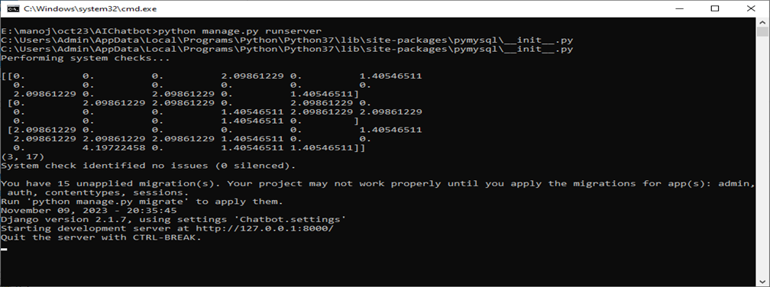
In above screen python web server started and now open browser and enter URL as http://127.0.0.1:8000/index.html and press enter key to get below page

Slide 26
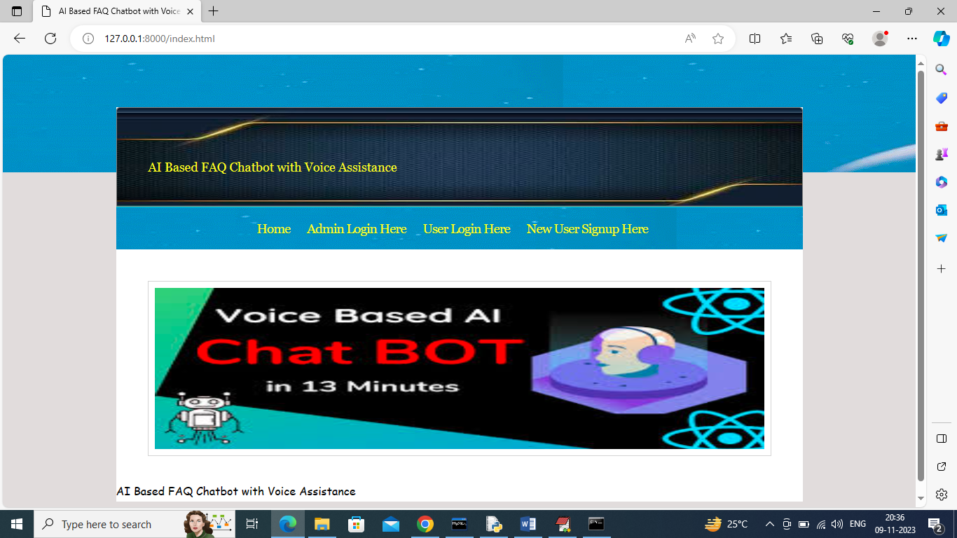
In above screen click on ‘Admin Login Here’ link to get below admin login page

Slide 27
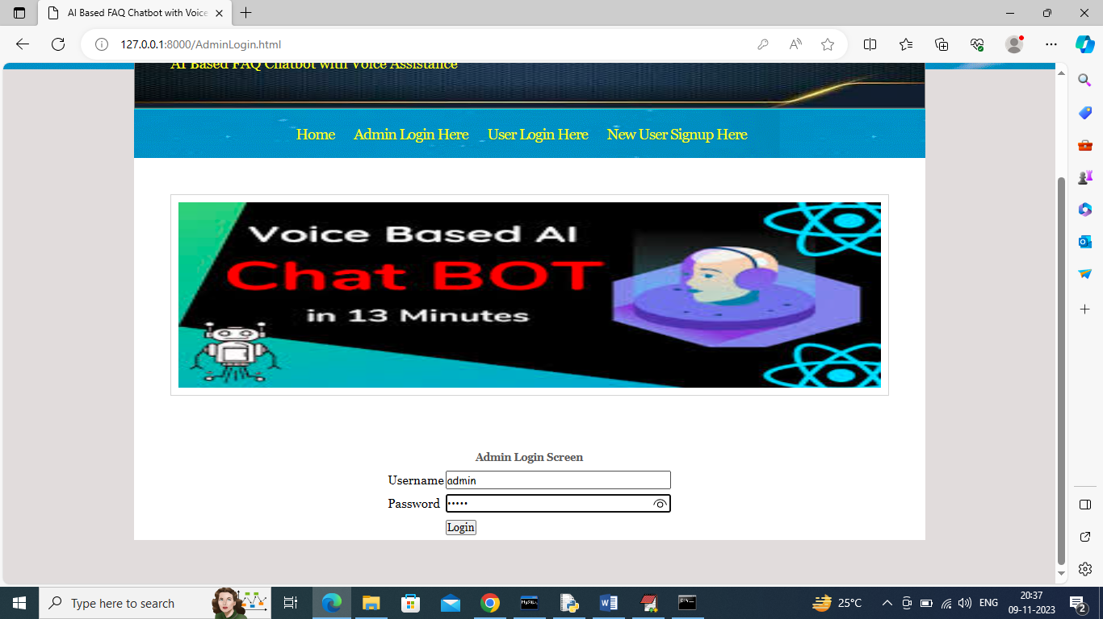
In above screen admin is login and after login will get below page

Slide 28
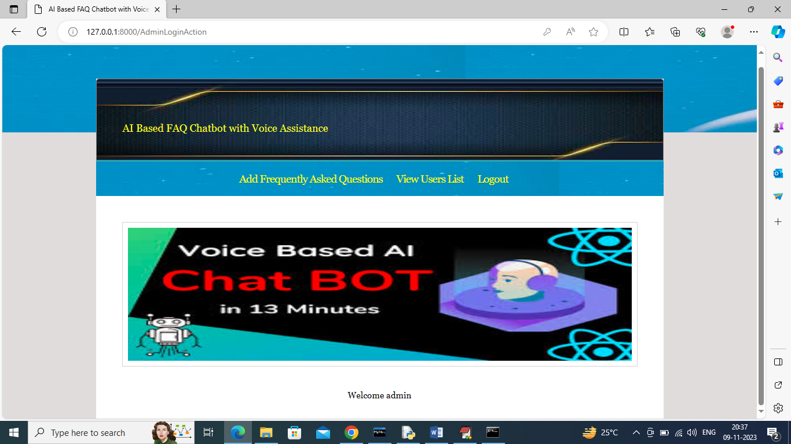
In above screen admin can click on ‘Add Frequently Asked Questions’ link to get below page

Slide 29

In above screen admin is adding new questions and then click button to save FAQ in database and get below output

Slide 30
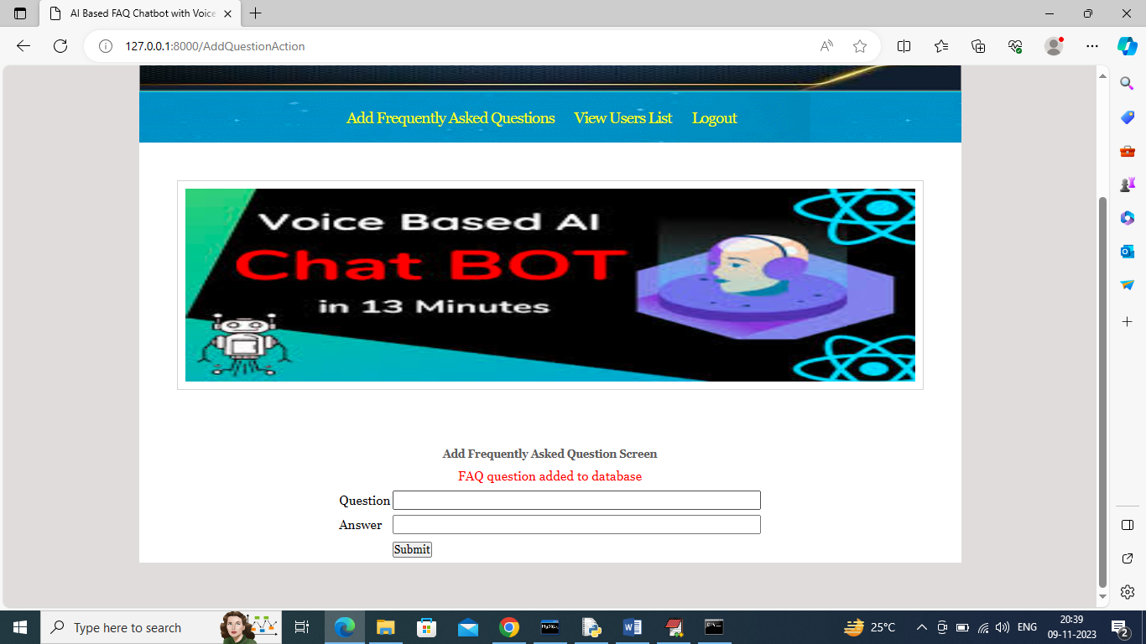
In above screen FAQ is added in database and now click on ‘View Users’ link to get below page

Slide 31

In above screen admin can view list of registered users and now logout and sign up new user

Slide 32
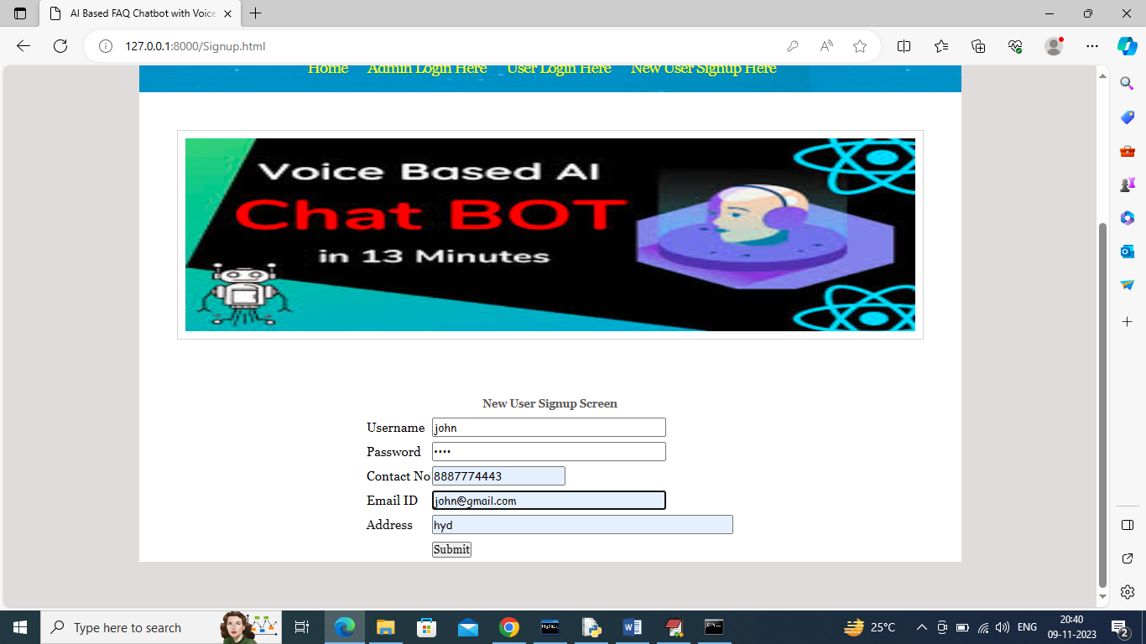
In above screen signing up new user and then click button to get below page

Slide 33
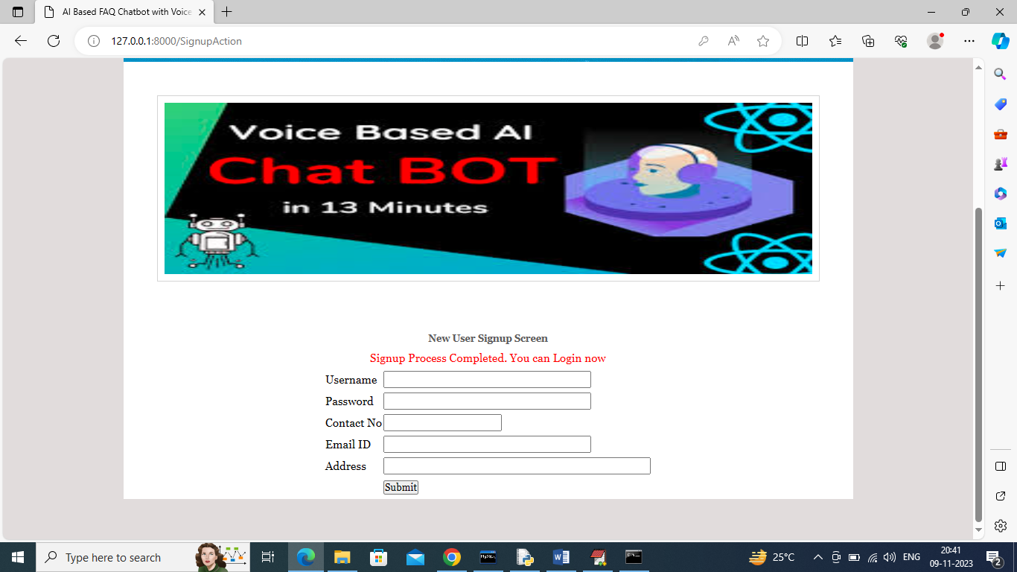
In above screen sign up process completed and now can login

Slide 34

In above screen user is login and after login will get below page

Slide 35
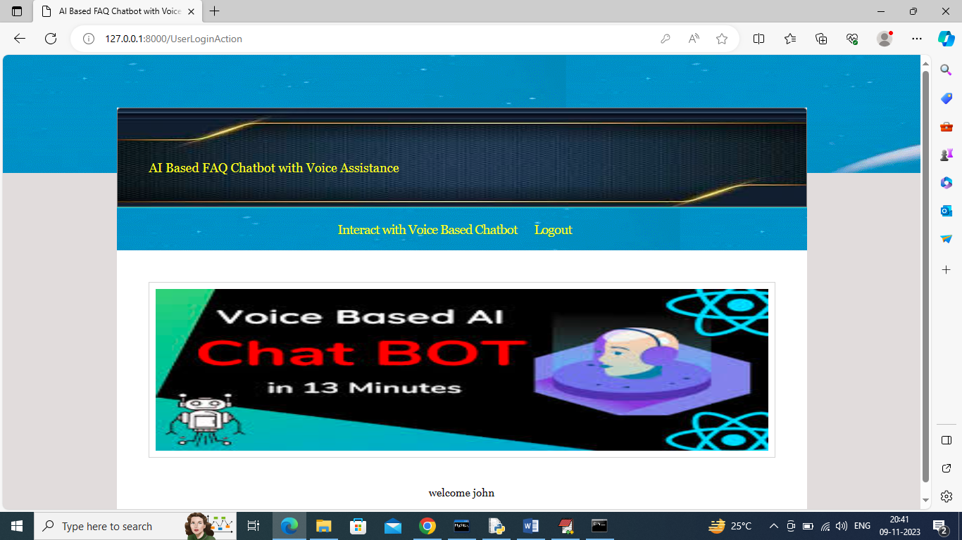
In above screen user can click on ‘Interact with Voice Based Chatbot’ link to get below page

Slide 36
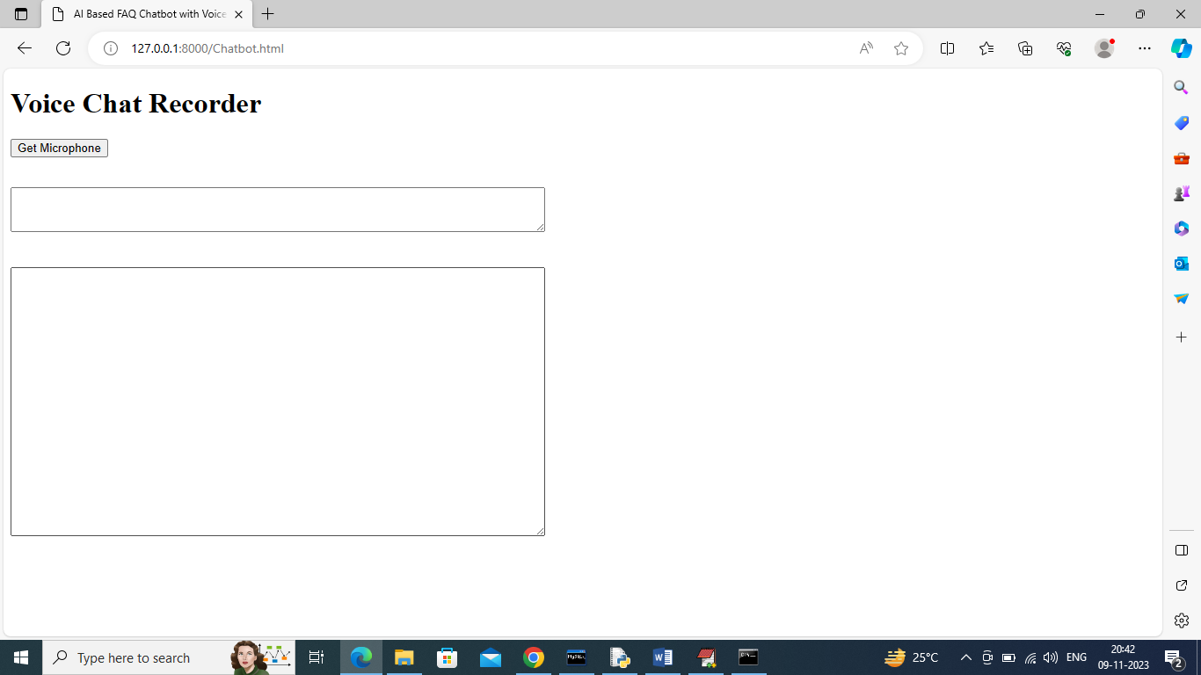
In above screen user can click on ‘Get Microphone’ link to connect to microphone and get below page

Slide 37
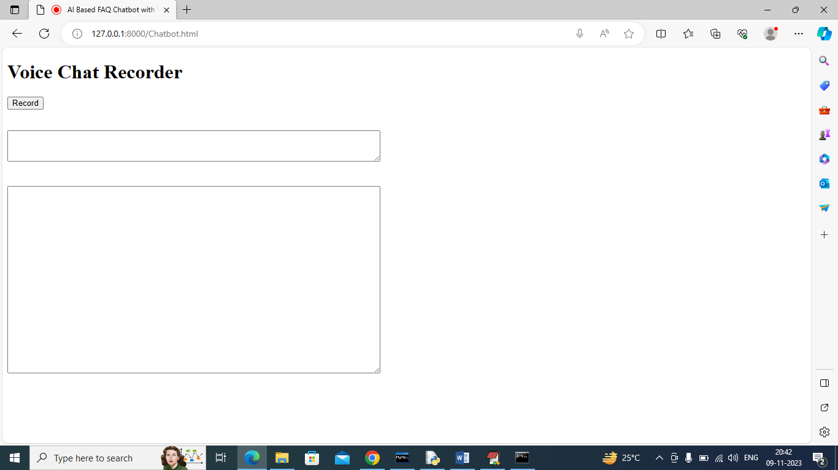
In above screen you can click on ‘Record’ button to record your voice and once done then click ‘Stop’ button to get response from Chatbot like below screen

Slide 38
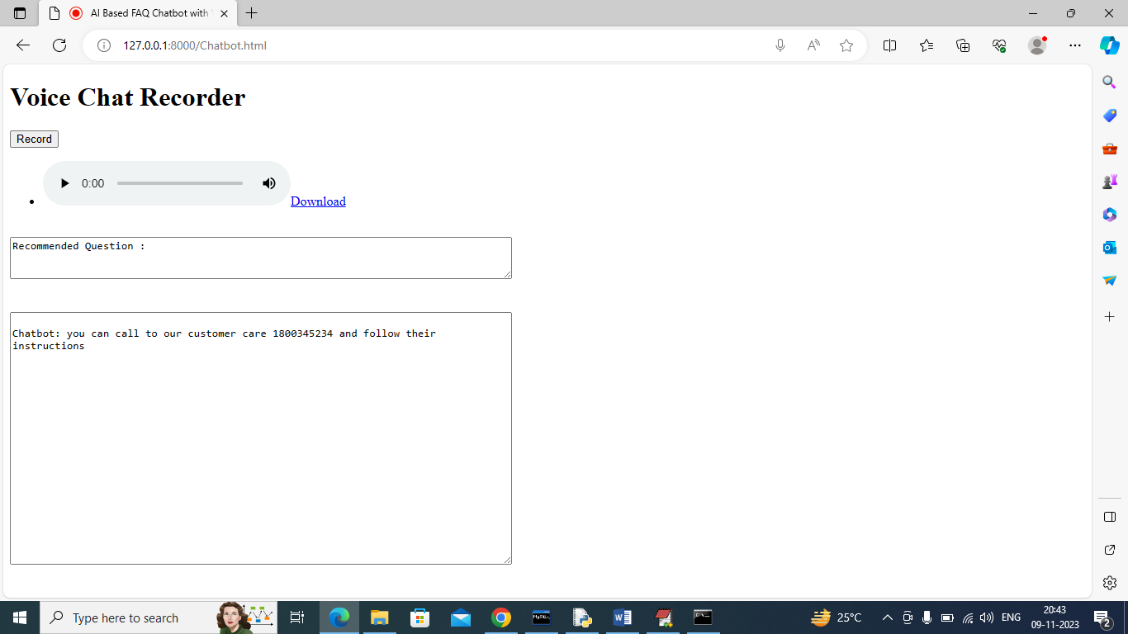
In above screen I speak some question about ‘return policy’ and then got above answer from Chatbot and whatever you record you can play and download any time. Below I am asking about working hours

Slide 39
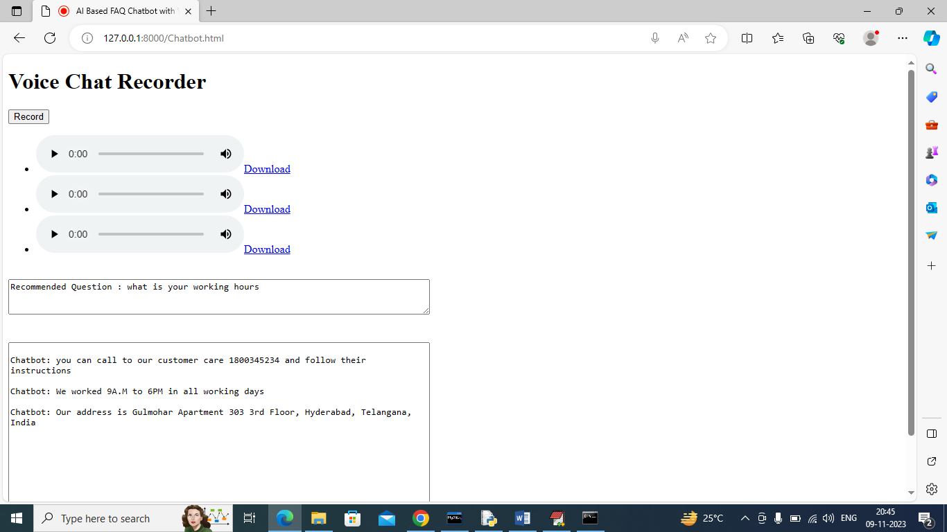
In above screen I sent some queries and then got replies from Chatbot and all those queries you can listen by clicking on Play button and can get recommendation question in first text box. In below screen I am asking unknown question

Slide 40
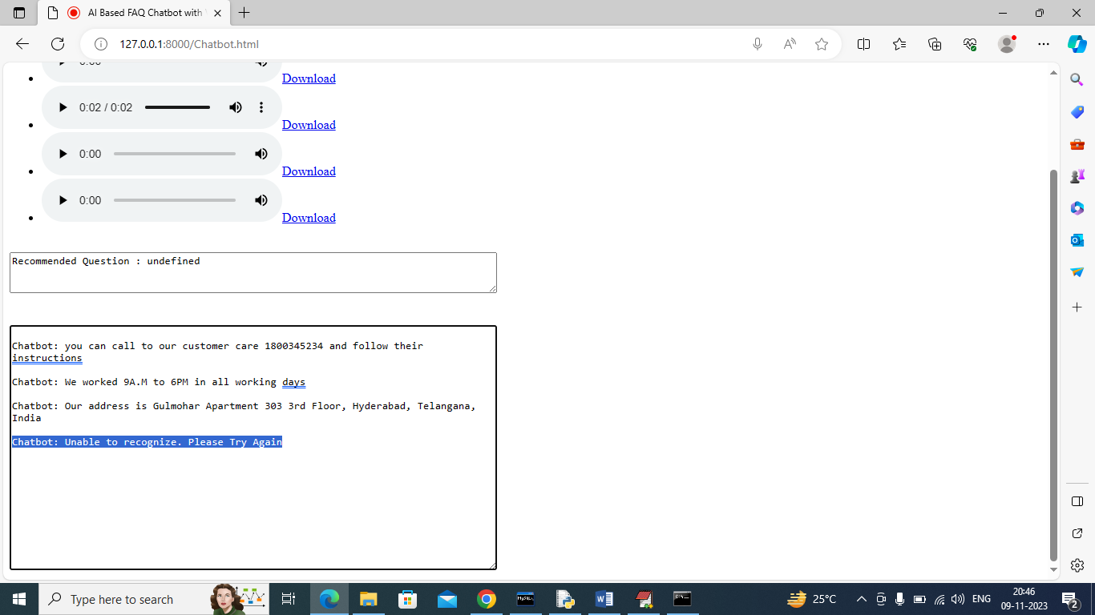
In above screen when I speak unknown question then Chatbot replied with ‘Unable to recognize and asked to try again’.
Similarly you can follow above screens to ask any FAQ question

Slide 41
Conclusion
Enhanced User Experience – The chatbot provides a seamless and interactive way for users to get
instant responses to their queries through voice input.
Voice Assistance Feature – By integrating speech recognition, the chatbot allows users to ask
questions verbally, making it more accessible and user-friendly.
Efficient Query Handling – The system uses TF-IDF vectorization and cosine similarity to match
user queries with the most relevant answers from the FAQ database.
Continuous Learning – New questions and answers can be added, ensuring the chatbot remains
up-to-date with evolving user needs.
Secure & Scalable – The chatbot is built with Django and MySQL, making it a reliable and scalable
solution for businesses and organizations.
Real-Time Responses – Users receive instant replies, reducing wait times and improving productivity.

Slide 42
Future Scope
Integration with Advanced NLP Models – Enhancing the chatbot with transformer-based models like BERT or GPT can improve contextual understanding and response accuracy.
Multilingual Support – Expanding language capabilities will make the chatbot more accessible to a global audience, enabling communication in multiple languages.
Voice Synthesis for Responses – Implementing text-to-speech (TTS) can allow the chatbot to respond verbally, making interactions more natural and engaging.
Integration with Smart Devices & Applications – The chatbot can be embedded into mobile apps, smart home assistants, and customer support systems for seamless interaction across different platforms.

Slide 43
References:
Lee, K., Shah, N., & Kim, J. (2020). "Voice Assistant Chatbot for FAQ Retrieval Using Machine
Learning." International Journal of Information Technology and Management, 19(3), 195-209.
hen, Y., & Liu, Y. (2019). "Development and Implementation of a Voice-Based FAQ Chatbot Using
Deep Learning." Proceedings of the International Conference on Advanced Intelligent Systems and
Informatics, 721-729.
Li, X., & Wang, Z. (2021). "Personalized FAQ Chatbot with Voice Assistance Based on Deep
Reinforcement Learning." IEEE Transactions on Cognitive and Developmental Systems, 13(4),
1120-1131. Nguyen, T., & Le, H. (2022). "Enhancing User Engagement with AI-Driven FAQ
Chatbots: A Comparative Study." Journal of Intelligent Information Systems, 1-18.
Smith, J., & Doe, J. (2018). "VoiceBot: A Conversational FAQ Chatbot with Voice Assistance."
Proceedings of the ACM International Conference on Information and Knowledge Management,
789-796.

Slide 44
Github Link:
https://github.com/BASKARUNIBASKARRAJU/AI-BASED-FAQ-CHATBOT-USING-VOICE-ASSISTANCE

